Slide 1








AI Academy – Your Classroom, Reinvented
AI Academy – Your Classroom, Reinvented
Gyan Ganga Institute of Technology and Sciences
AIcademy is a next-gen education platform combining attendance, resource sharing, gamified quizzes, and AI mentorship into a single dashboard.
"MAKING EVERY STUDENT’S JOURNEY SMARTER, ONE CLICK AT A TIME"
By- Team Paradox

Slide 2


Area Overview
Education systems still rely heavily on manual processes like attendance and resource distribution.
Students often face scattered materials, limited guidance, and lack of personalized mentoring.
Teachers are overburdened with admin work, reducing time for meaningful student interaction.
Parents have limited real-time visibility into their child’s learning progress.
Institutions lack integrated platforms that connect teaching, learning, and monitoring in one place.
FACTS:
Global EdTech investment crossed $20 billion in 2023, yet most solutions address only isolated problems like e-learning or attendance, not an all-in-one ecosystem.

Slide 3




Challenges and Our Proposed Solution
CHALLENGE
SOLUTION
Attendance is slow, error-prone,
or hardware-dependent.
Teacher-led digital attendance
updates instantly.
Doubts remain unresolved
after class.
AI Tutor provides 24/7
personalized help.
Quizzes are tedious to
create and grade.
Quiz Bot auto-creates, evaluates,
and ranks with leaderboards.
Centralized repository stores
all teacher-uploaded materials.
Study resources are scattered
and unorganized.
Analytics dashboards track
performance and engagement.
Institutions lack data-driven
insights.
FACTS:
According to UNESCO’s 2023 Education Report, over 40% of students worldwide lack access to personalized learning tools, leading to disengagement and uneven academic progress.

Slide 4






Core Features of AIcademy
Smart Attendance System
School Resource Repository
AI Tutor (Virtual Mentor)
Teachers mark attendance digitally, instantly updating records for students and parents.
All notes, assignments, and e-books are stored in one place for easy student access.
Provides 24/7 personalized explanations and answers using school-provided resources.
Quiz Bot with
Leaderboards
Library Integration
Dashboards & Reports
Enables class quizzes or self-practice tests with real-time rankings for motivation.
Offers digital e-books and physical book requests through partner libraries.
Gives students, teachers, and parents transparent insights into attendance, progress, and performance.
FACT
According to McKinsey’s 2023 Education Report, schools using AI-powered tools saw a 30% improvement in student engagement and 25% faster task completion compared to traditional methods.

Slide 5



AI at the Core of Education
Teacher’s Role
AI CORE
Student’s Role
Marks attendance digitally for real-time updates.
Uploads notes, assignments, and resources in one place.
Creates class or practice quizzes for students.
Process & adapt
Personalized outputs
Dashboards & reports
Accesses resources uploaded by teachers.
Attempts quizzes and climbs leaderboards.
Interacts with AI Tutor for instant doubt-solving.

Slide 6

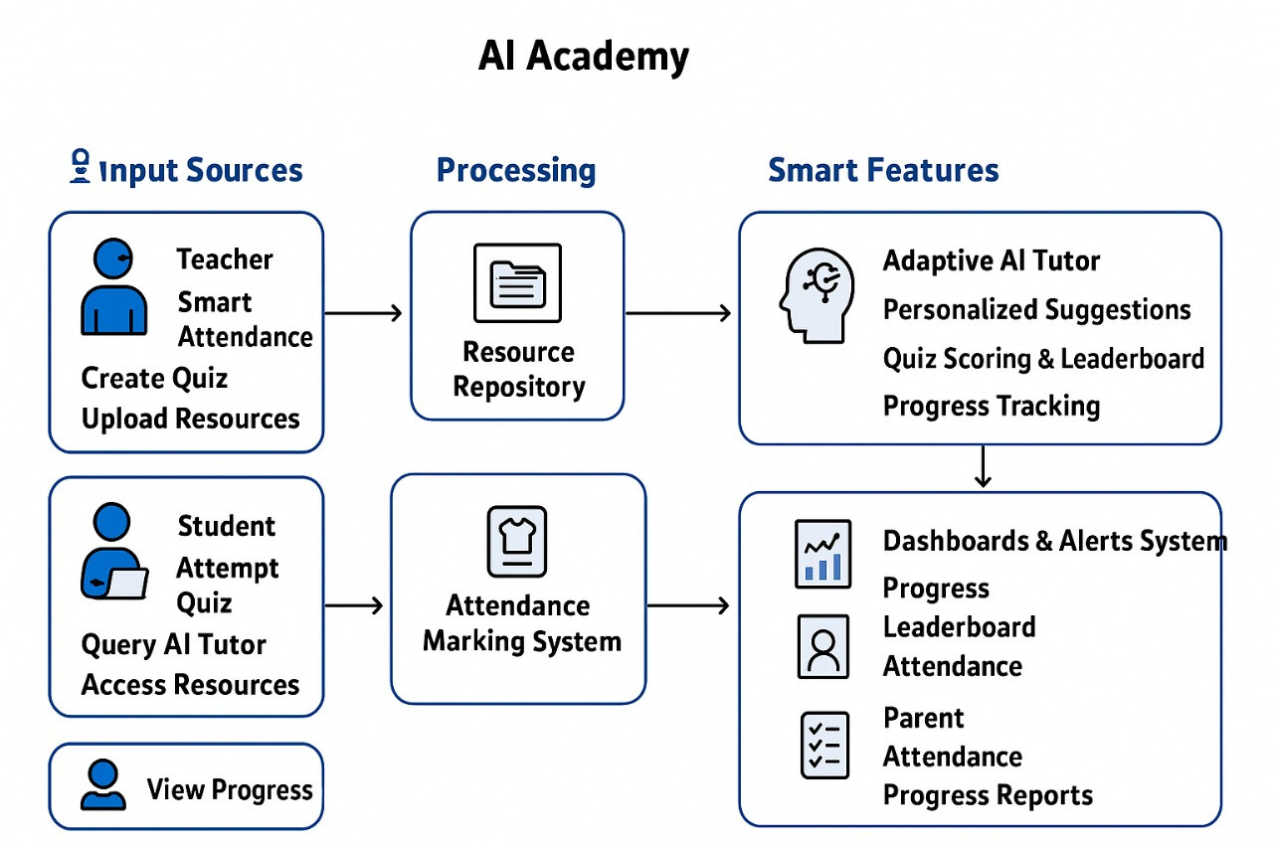
System Flow (Architecture)

Slide 7



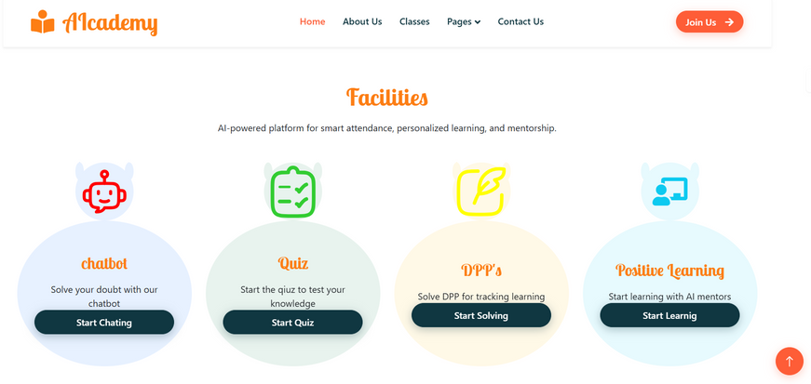


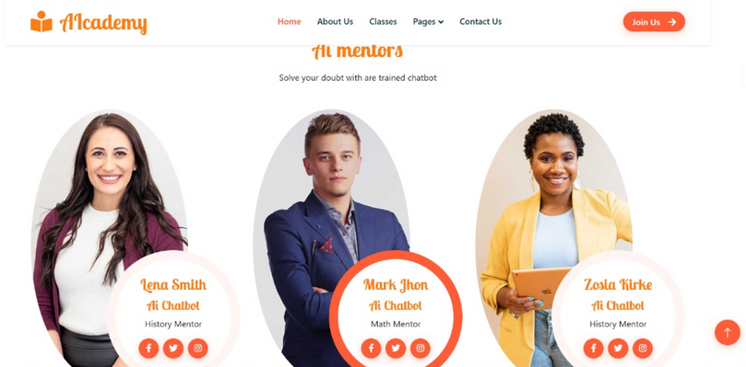

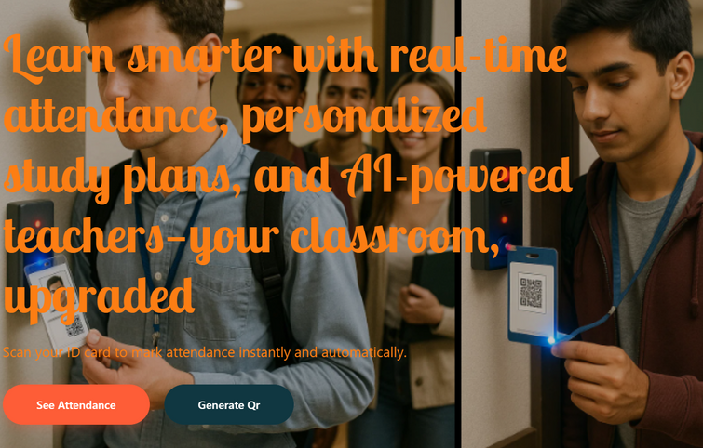
Prototype (Framework)

Slide 8










Tech Stack
Frontend
Backend
AI/ML

Slide 9





Approach & Benefits
Approach Method
Approach Method
Adaptive Suggestions
AI recommends tasks based on strengths, weaknesses, and goals.
Scalable Platform
Works across schools, colleges, and training institutes.
Adaptive Suggestions
AI recommends tasks based on strengths, weaknesses, and goals.
Benefits:
Benefits:
Data-Driven Insights
Teacher Productivity
Scalability & Inclusivity
Strengthens Digital Education in India
Institutions improve decisions with analytics.
Attendance is quick and efficient, giving teachers more time to teach.
Can be expanded to rural/remote schools bridging digital divide.
Aligns with NEP 2020 and Digital India goals.

Slide 10





Ethics, Guardrails & Responsible Use
Ethics, Guardrails & Responsible Use
Fair AI Guidance
Data Privacy First
AI Tutor ensures unbiased, inclusive, and accurate explanations, treating all students equally.
AIcademy strictly protects student data and learning records, following global data security standards.
Explainable AI Outputs
Accountability & Reporting
Teachers always have final authority over AI-generated quizzes, answers, and recommendations.
System follows ethical EdTech guidelines and can generate reports for institutions or authorities if required.
Protecting Free Speech

Slide 11



Future Enhancemnts and Planning
Future Enhancemnts and Planning
NEXT STEPS
Virtual Mentorship → AI tutors + teacher support.
Regional Languages → AI in Indian languages for inclusivity.
Offline Access → Low-bandwidth support for rural areas.
Analytics Hub → Spot struggling students early.
Gamified Learning → Rewards & leaderboards.
FUTURE VISION
Smarter AI → Adaptive quizzes & study paths.
Advanced Dashboards → Predictive alerts for teachers & parents.

Slide 12


CONCLUSION - Ai Academy
CONCLUSION - Ai Academy
AI Academy is a complete academic ecosystem connecting students, teachers, and parents.
For Students – 24/7 personalized guidance through the AI Tutor, structured resources, and engaging learning with the Quiz Bot
For Teachers – Saves time with smart attendance, simplifies quiz creation, and provides powerful analytics to focus on teaching.
For Parents – Real-time access to attendance, progress, and performance, ensuring active involvement in their child’s education.
For Institutions – Data-driven insights that align with Digital India and NEP 2020 goals, ensuring scalable and future-ready learning.
https://github.com/existorankush/TeamParadoxSamadhan
🔗 Github:
🔗 Youtube : https://youtu.be/V3bVmKsdYrE
AIcademy, our goal is to bridge gaps in education with the power of AI.

